Slide 1
ACI data science for PRM - Overview
February 2019
Bernard Chartier
ACI Data Science Team

Slide 2
Outline
Data Science and Business Requirements
Model Development Process
Sample Predictive Performance
Data Science Roadmap

Slide 3
Data Science Professional Services Overview

Slide 4
Professional Service Offerings
Model Maintenance Program
1 model per quarter
Continuous data transfer required
Segment models
Recent enhancement to data science process to enable development of 3 models in time similar to single model
Development and delivery time - 5-8 staff-weeks, data conditions apply
Segments include
PIN, signature, CNP
International vs domestic
Custom model for largest FIs of a processor
Based upon statistical analysis for largest FIs and processors

Slide 5
Target Products and Channels
Primary offerings
Credit
Debit
Consortium models for processors and switches
Merchant
Requires additional development
Online banking
Money laundering detection
ACH
Wire
Branch / core banking

Slide 6
Faster Payments
Differ from traditional card products
20022 message
Currently primarily email money transfer
Limited data elements
Versus full payment messages
Geolocation fields may be available
Purchases not supports – P2P transfers
Primarily low dollar amounts
Corporate transfers introduced later
Currently limited low-dollar corporate traffic
ACI will maximize value of all available data elements and archived data for fraud model development

Slide 7
Business / Use Cases
Model as primary fraud detection mechanism
Rule and enhanced profiles developed around model
Complementary detection mechanism
Targeting approved debit losses only
Existing detection mechanisms remain in place
Cost savings
Reduced false positives
Reduced analyst alert processing
Revenue generation tool
For processors offering fraud prevention as value-add service to their FI customer base

Slide 8
Standard Project Deliverables
Business Requirements Document
Data Validation Presentation
Primary model deliverable
PSE executable
Machine learning model
Control files
Installation validation dataset
Installation documentation
Model Performance Presentation

Slide 9
Data Science and Business Requirements

Slide 10
Machine learning at ACI
ACI data science group
Dedicated team of multiple M.S. and Ph.D. data scientists
Experienced practitioners
Researchers – Theoretical and applied
Senior and principal data scientists
Over 23 calendar years and 80 staff-years of machine learning algorithm, data science and software design and development experience
Directly applied to retail and banking fraud detection
Augmented by
Global risk management team of risk analysts
ACI’s Application Development team of software engineers

Slide 11
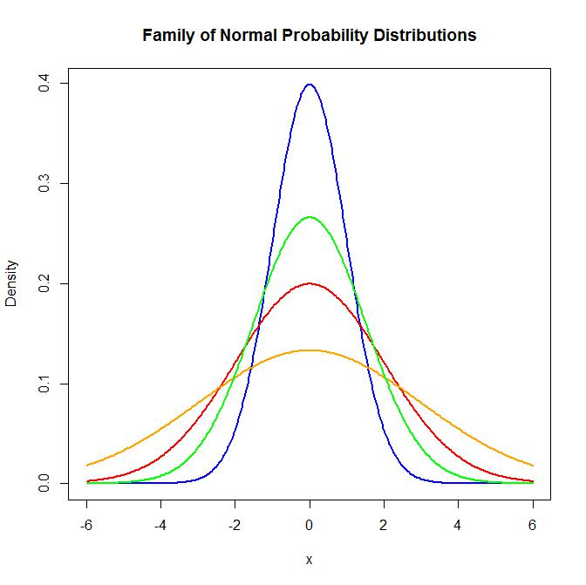
Machine Learning for Fraud Detection
Characteristics of Fraud
Fraud detection intrinsically complex condition
Probabilistic – Quantify uncertainty, versus deterministic
Data volumes – Requires scaling to hundreds of millions of records
Non-linear – Higher fraud detection rates require non-linear classification method
Non-separable – Overlapping class distributions
Even when modeling highly expressive feature suite
Higher dimensionality – Higher fraud detection rates require models developed with larger number of features
In comparison with number of conditions in typical fraud detection rules
Time series – Transaction data is time-dependent across multiple indices
Statistical stability – Score used to detect fraud needs to exhibit stability across multiple variables (time, products, channels, geographies, etc)
Stochastic component – Human behavior has random component
Operational characteristics – Fraud operations impose requirements on score
Precise control over alert volumes
Consistent / low false positive rates
Machine learning algorithms address these requirements

Slide 12
Data Science
Business Requirements
Payments / Fraud
Probability Theory / Information Theory / Decision Theory
Statistics
Machine Learning Theory
Data Processing / Software engineering
All banking channels / products – Credit, debit, wire, online banking
Business requirements drive all analytics
Terabytes of data in DBMS / SQL, data transformation, software development, etc
Classification / regression algorithms, feature selection, dimensionality reduction, etc
Probability distributions, entropy, KL Divergence, etc
Descriptive statistics, population statistics, non-parametric tests, correlation analysis, etc

Slide 13
Business Requirements
Target portfolio or product
Debit / credit / wire
Consumer, commercial, pre-paid, fleet / fuel
Identify target detection set
Approved only or approved and declined transactions
Normally optimize model on approved fraud only but present model performance under both conditions

Slide 14
Business Requirements
Identify model performance metrics
Defined by customer
Could be either transaction-centric or account centric
Percent fraud transactions detected
Transaction / account false positive ratio
Percent opposable amounts saved
Earliness of detection
Operating region
Defined by either number of alerts per day or false positive region

Slide 15
Business Requirements
Identify impact of production environment
Which transaction types will be available / scored versus archived data used for model
Fields available in archive versus production
PRM Input Process
Modeling data needs to mirror PIP output
Normally optimize model on approved fraud only but present model performance under both conditions
Production throughput and latency requirements
Significant consideration for real-time implementation
I/O is primary factor, CPU is secondary

Slide 16
Model Development Process
Overview

Slide 17
Typical Data Requirements
Recent authorizations – sufficiently aged
Account monetary and non-monetary data
Confirmed fraud data – Fully reported and exclusive of disputes
Recommend training / testing on minimum of 6 months
Training (80%)
Testing (20%)
History

Slide 18
Data Security
Data security critical to ACI and financial institution
Data securitization
Card, account, UAN – Hash or renumbered
Personally identifying information masked
Names
Address – other than postal code
Phone number – other than area code
Government ID
etc
Transfer via ACI SFTP server

Slide 19
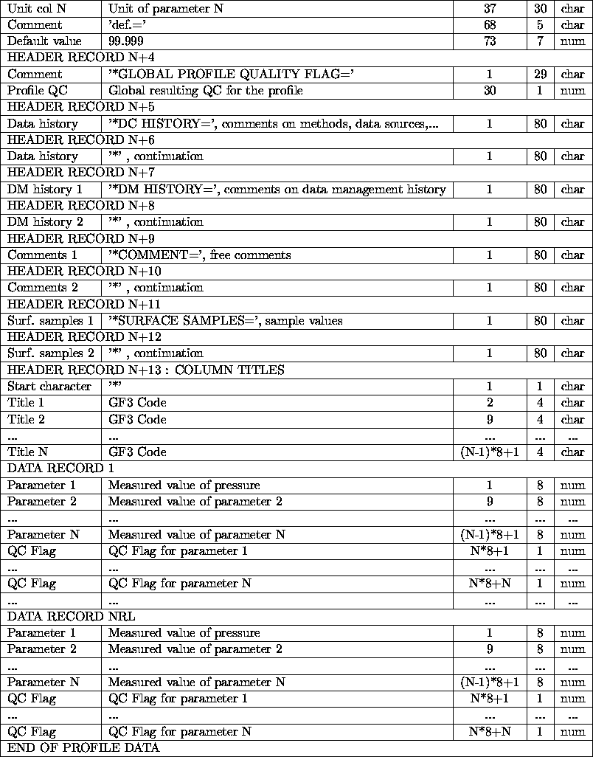

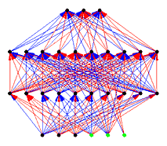
Process Summary
Training and Testing Data
PRM Model Development Process
Machine Learning Model
6 Months

Slide 20
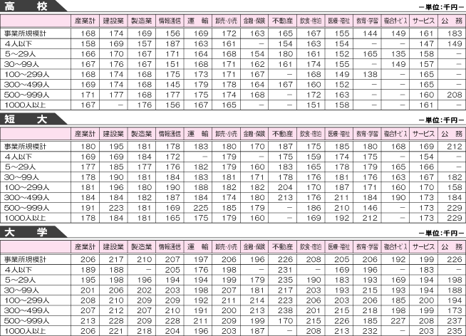

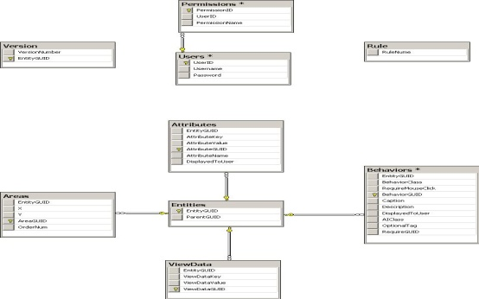
Data Validation and Preparation
All authorization fields
Processes executed
Down-sample
Label with confirmed fraud
Validate
Visualize
Segment datasets train / test / validate
Outputs
Data validation presentation
Model development datasets
Project transfers from senior data analyst to modeler
Multiple Processes
Data Validation and Preprocessing
Model Training and Testing Data
Confirmed Fraud – PRM / SAFE / TC40 / PIN

Slide 21
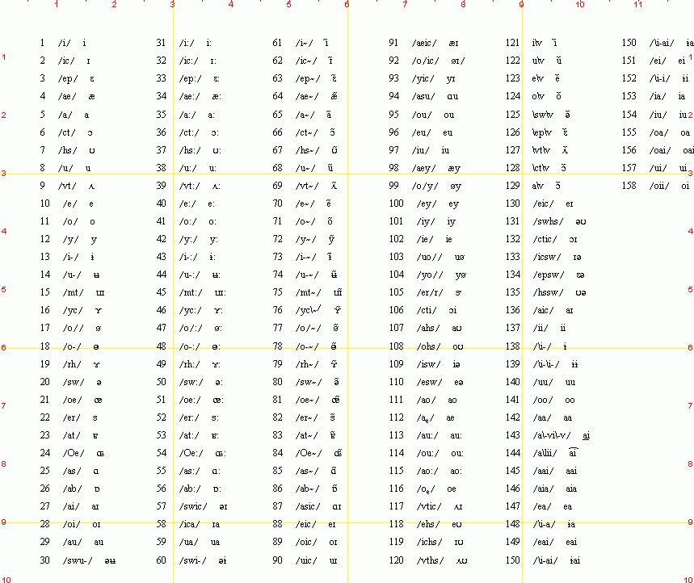

Risk Table Generation
Risk tables
MCC
Terminal postal code
Any categorical field
Segmented
CP vs CNP
International vs domestic
Etc
Bayesian
Table generated by machine learning model
Sampled Labeled Transactions
Risk Utilities
Sample table: Hour of day

Slide 22
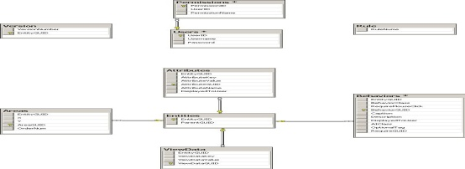
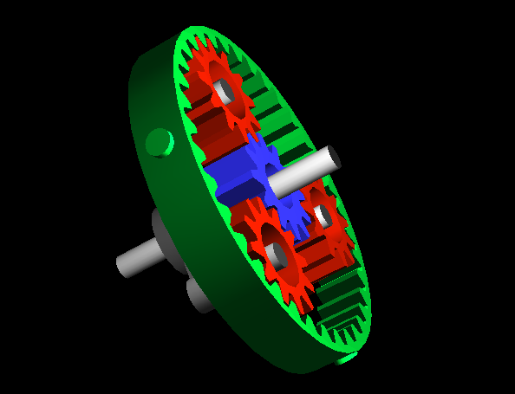
Develop, Generate and Optimize Features
Processes executed
Key area of data science investment
Parameterization of features
ACI maintains and expands suite of thousands of derived data variables
Develop features custom to portfolio, fraud and genuine patterns
Generate features for training and testing datasets
Optimize feature ranges
Identify discriminant feature subsets for initial model generation
Outputs
Formatted training, testing, validation datasets
Modified feature ranges
Multiple feature subsets
Sampled Labeled Transactions
Risk Tables
Feature Generation
Formatted Transactions
Training and Testing Data

Slide 23
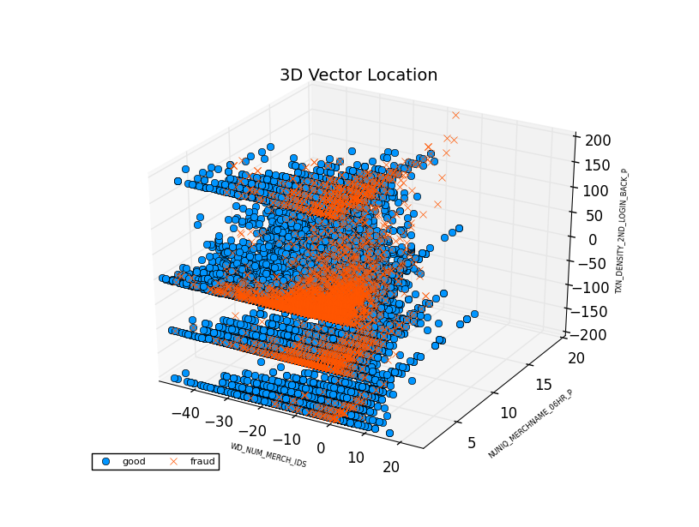
Feature Selection and Analysis
Thousands of derived data variables available for possible inclusion in model development
Objectives of this model development stage
Evaluation of feature distributions
Generation of multiple higher performing features subsets for initialization of model optimization cluster
ACI employs multiple complex feature selection methods
Generation of optimum feature ranges
Automated via ML algorithm and heuristics

Slide 24
ACI’s Machine Learning Algorithms
Utilized in multiple stages of model development
Machine learning algorithms used in multiple model development processes and utilities
Features utilizing incidence tables – subset generated with ML algorithm
Feature range optimization
Feature selection
Iterative model optimization
Classification algorithm
Algorithms used for production scoring
Two – Primary algorithm is proprietary neural network

Slide 25
ACI’s Machine Learning Algorithms
Next generation classification algorithms being productized
Currently completing NFR testing
Achieve higher model predictive performance than existing productized algorithms
Capable of representing thousands of features
Significantly more than existing productized algorithms
Require significant less time to achieve higher performance
Serve as both classifier and feature selection
Providing equally high dimension feature selection function

Slide 26

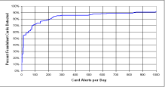
Cluster Optimization
Optimized search of model parameter space
Model Optimization Cluster – Combinatorial Genetic Algorithm
. . .
PSE 1
PSE 2
Training and Testing Data
Automated Model Train / Valid Hyper-param tuning
Customized form of distributed computing
Federated – Multiple nodes operate under central control
Parallel – Multiple processes execute simultaneously
Distributed – Across multiple core, servers
Recent update – Genetic algorithm-based feature optimization

Slide 27
Sample Predictive Performance

Slide 28
Dataset
Mid-tier US domestic issuer
Credit portfolio
Includes small percent of commercial cards
Model optimized for detection of
Approved and declined
Card present and card not present
Primary performance metric
Percent fraud transactions detected versus daily alert volume

Slide 29
Model Development Process Summary
Percent Fraud Transactions Detected vs Transaction False Positive Ratio
Percentage Fraud Transactions Detected
Fraud Score: 699
Daily Transaction Caseload: 1509
False Positive Ratio: 4:1
% Fraud Transactions detected: 32.72%
Transaction False Positive Ratio

Slide 30
Model Development Process Summary
Percent Fraud Amount Alerted vs Transaction Alerts per
Percent Fraud Amount Alerted
Fraud Score: 699
Daily Transaction Caseload: 1509
False Positive Ratio: 4:1
% Fraud Amount Alerted: 45.30%
Transaction Alerts per Day

Slide 31
Machine Learning Research
Ongoing Investment

Slide 32
New Machine Learning Algorithms
Core fraud detection mechanism
ACI advancing core fraud detection mechanism
Machine learning algorithms
Current research project consists of
Champion / challenger evaluation of latest machine learning algorithms against current productized set
Extension of model segmentation
Increasing the number of segments and complexity of segmentation criteria
Productization ‘off-ramp’
Highest performing algorithms transferred out of research for productization into USE or PRM scoring engine
WPI internship program

Slide 33
Research Architecture – Model Training
Additional pipeline components
Multi-core virtualized research environment
Hyperparam Opt
Input Data -
Training, Validation and Test
Clustering
And Rebalancing Algorithms
Cluster #1
Feature
selection
Classification/
Anomaly detection on training, validation and test subsets
Aggregate Results
Hyperparam Opt
Classification/
Anomaly detection on training, validation and test subsets
Cluster #2
Feature
selection
…
…
…
Hyperparam Opt
Cluster #K
Feature
selection
Classification/
Anomaly detection on training, validation and test subsets

Slide 34
Sample Model Predictive Performance
New Algorithm

Slide 35
Performance Improvements
Against Productized Algorithms
Data | Operating Point | Test Set | Best New Algorithm | New Algorithm Performance (%) | PRCE (legacy) Performance (%) | Percent Difference (%)
FI 1 | 1,500 TxnAlertsPerDay | T2 | XGB-TR | 31.31 | 27.52 | 13.77
RS-RTL | 10,000 TxnAlerts/Day | T2 | SVM | 69.36 | 56.64 | 22.46
RS-GAM | 2:1 TxnFalsePositiveRatio | V1 | XGB-TR | 23.69 | 25.46 | -6.95
FI-PROC 3 MTH | 1,500 TxnAlertsPerDay | T1 | XGB-TR | 22.39 | 15.50 | 44.45
FI-PROC 6 MTH | 20:1 AcctFalsePositiveRatio | V1 | SVM | 37.8 | 28.7 | 31.7

Slide 36
Data Science Roadmap
Planned Initiatives

Slide 37
Planned Investments in Machine Learning
ACI investing in core data science offering
Primary data science roadmap objectives
Improving predictive performance
Increase detection rates, decrease false positive rates
eg: Evaluate alternative machine learning algorithms
Decrease model development and delivery time
Continuous incorporation of changing and expanding payments / channel and fraud behavior landscape
eg: bot attacks
Non-functional requirements
Scaling with customer volumes
Model shelf life

Slide 38
Data Science Roadmap Snapshot
Timeframe TBD
Timeframe TBD
Timeframe TBD
PRM – ReD Shield
Increased Detection
Parameterized Features
Combo of Partial Automation & Parameterization
Full Automation of Feature Generation
Automated Feature Discovery and Engineering
Business Requirements - NFRs
ML Algorithms
Higher dimension and unsupervised
Anomaly detection
Deep learning
Committees
Adversarial ML
Small-Segment Models
Multi-Model Segmentation
Channel Segments - PIN, Sig, CNP
Unsupervised multi-model small committee
Unsupervised multi-model large committees
Hierarchical networks/large committees
Frequency of Model Training
Multiple Per Year
Model-per-day
Near-time learning
Continuous Learning
Real Time Learning
Role of Data Scientist
Pipelines - Partial Automation
Full Automation – Distributed Pipelines
Unsupervised algorithms
Algorithm Architecture and Design
Data Sources
PRM Profiles
Geolocation
“Big Data” initial
Big Data, Unstructured data incl speech/video
Website behavior
IOT/network and in-stream
HW / Frameworks / Infrastructure
Hadoop / Spark / Multi-core / GPU
Many cores / GPUs
Distributed frameworks on HPC
Next Gen Fraud Prevention
UP

Slide 39
Machine Learning Automation
Roadmap objective - Significant reduction in model development time
ACI has been investing in automation of data pre-processing and model optimization
Model development time reduced from 18 staff-weeks to 3-4 in past 3 years
Conditions apply
Delivery time will decrease further with additional planned 2019 automation
Targeting three workstreams
Machine learning research
Full model train and deployment into AOD in 2-4 staff-weeks
For full portfolio or large segments
Segment model and deployment into AOD in 1 staff-day
For rapidly evolving fraud types and smaller segments
Continuous learning
Model parameters updated immediately following user-defined events
Eg: confirmed fraud

Slide 40

Target Process
Data Science
AOD - Prod
Streaming Data
R&D
Data Scientist
VM₁
D₁
New algorithms, features, methods
…
Research Datasets
PSE / USE
PRM
VM_{n}
D_{n}
AG
Ongoing
Full
Model
Development
VM₁
D₁
M₁
Data Scientist
Automated
Deployment
Automated
Deployment
Continuous
Learning
…
Full MDD
…
PRM DB
Confirmed
Fraud
Feature subsets, hyper-params, etc
M_{n}
Internal Network
VM_{n}
D_{n}
2-3 weeks
Segment
Model
Development
M₁
Data Scientist
VM₁
D₁
Customer
Data
Models
ACHD
Models
…
Segment Datasets
…
Model
VM_{n}
D_{n}
M_{n}
1 day
PRM Customer
Risk Manager / Analyst
PRM
Workstation
Model change requests, fraud patterns, etc
…
…
Risk Manager / Analyst
PRM
Workstation

Slide 41
Model Development Pipeline
Automation Progress
Most complex stages of model development process have been automated
Primary remaining stages are data preparation and validation and model benchmarking
Data Transmission
Feature config and generation
Model optimization
Sample preprocessing
Incidence table generation
Validation and sampling
Data Preproc
Feature preprocessing
Feature range optimization and selection
Model benchmarking
Model deployment
20% Complete
90% Complete
0% Complete

Slide 42
Universal Scoring Engine
USE

Slide 43
Universal Scoring Engine
Models developed by ACI
Deployed with PRM Scoring Engine
PSE
Model developed by customer
Deployed with USE
Features
PRM feature engine
Enhanced Profiles
ERIF data elements

Slide 44
USE Capabilities
Fully integrated with PRM
Implements models in PMML
PMML 3.x or 4.x
Supports wide variety of machine learning models
Models: Neural networks, SVM, Naïve Bayes classifier, Gradient boosting, Random forest, others
Very low latencies through native compilation
Uses PMML converter to natively convert PMML to bytecode
Horizontal scalability

Slide 45
USE Capabilities
Live model deployment results in no down-time
Supports implementation of multiple models
Algorithms applied in parallel, scores calculated and returned to Analytic Gateway
NFR factors
Number of model parameters
Number of data elements required for features
Feature complexity

Slide 46
Big Data
2019 Roadmap Initiative

Slide 47
Big Data Sources
ARCHIVES – archives of scanned documents, statements, forms, customer correspondence paper archives and print stream files that contain original systems of records between organizations and their customers.
DOCS – XLS, PDF, CSV, email, Word, PPT, HTML, HTML5, plain text, XML, JSON, etc.
MEDIA – images (JPEG/JFIF, TIFF, PNG, WebP, BPG, etc.) , video (MPEG4, AVI, FLV, WebM, etc.), audio, Flash, live streams, podcasts, etc.
DATA STORAGE – SQL, NoSQL, Hadoop, doc repository, file systems, etc.
BUSINESS APPS – project management, marketing automation, productivity, CRM, ERP content management systems, HR, storage, talent management, procurement, expense management, Google Docs, intranets, portals, etc.
PUBLIC WEB – government, weather, competitive, traffic, regulatory, compliance, health care services, economic, census, public finance, stock, OSINT, World Bank, SEC/Edgar, Wikipedia, IMDb and other Web services.
SOCIAL MEDIA – Twitter, Facebook, LinkedIn, YouTube, Google+, Yahoo, Tumblr, Instagram, Blog, SlideShare, Flickr, Pinterest, Vimeo, WordPress, IM, RSS, Review, Chatter, Jive, Yammer, Yelp, etc.
MACHINE LOG DATA – Event logs, server data, application logs, business process logs, audit logs, call detail records (CDRs), mobile location, mobile app usage, clickstream data, etc.
SENSOR DATA – security cameras and sensors, smart electric meters, car sensors, road cameras, cable boxes or household appliances, office buildings, etc.

Slide 48
Big Data Model Types
Deep Learning models – are used for image recognition (Facebook’s DeepFace, CNN), voice and speech recognition (LSTM), natural language processing (DLNLP), prevention of DDOS attacks (RNN)
OpenCV's Haar and Local Binary patterns (LBP) detection methods(both are variants of cascade Viola-Jones face detection algorithm) and SVM are used for face recognition in images. These methods yield in accuracy to DeepFace.
Probabilistic graphic models – are used to identify networks of people on social networks (Twitter, Facebook, LinkedIn and etc.)
Hidden Markov Models, Latent Dirichlet Allocation and SVM are used for natural language processing (NLP) in modern general purpose speech recognition systems. Recently many aspects of speech recognition and NLP have been taken over by LSTM and DLNLP (Nuance, Google, Twitter, Alibaba Group and etc.)
Time series methods are used for anomaly detection.
Naïve Bayes and SVM models are used for the document classification
Dimensionality reduction and feature selection techniques could be used in all models mentioned above as a preprocessing step.

Slide 49
Big Data Properties
Volume: Vast amount of stored data that can be gathered and analyzed effectively. 40 zettabytes of data are estimated to be created each day by 2020
Type: Type of data that may be structured, semi-structured and unstructured. Due to different types of data like pdf, word document, excel/spreadsheet, audio, video, service and application logs; the format of data and the way it should be stored, also differs.
Dynamic / changes: Rate of data change and speed of data available for analysis. Every minute over 200 million e-mails are sent, around 20 million photos are viewed
Data integrity: Data integrity and extend of trust in the data to confidently use it to make decision.

Slide 50
Implementation Approach
Titanium will implement infrastructure for unstructured data storage
Combination of internal build and product purchase
Models developed on structured data is foundation
Work with established vendor for data sourcing
First implementation in AOD

Slide 51
Thank You!

